Slide 1
Miner
Safety Helmet
GROUP NO: 28
IN 1901 - Microcontroller Based Application Development Project

Slide 2





Group members
T. A. S. I. Jayalath
214086K
A. M. C. I. Athapaththu
214023R
A. D. R. V. Abeysiri
214007X
W. A. T. M. Thilakarathna
214211R
A. S. F. Sahla
214177P

Slide 3

Introduction
This Project creates a special helmet for miners' safety.
The helmet has sensors to detect dangerous gases and temperatures.
It enables communication using audio transmission
The goal is to make mining safer and protect miners.
The helmet helps miners avoid hazards like harmful gases, extreme temperatures.
The project improves safety and prevents accidents in mining.
The helmet gives real-time data to help miners stay safe.
Overall, the project makes mining a safer job for miners.

Slide 4
Problem in brief
Mining is a dangerous job with many risks and injuries.
Miners urgently need a safer helmet with advanced features.
There are harmful gases for human inside Mines.
They don’t have the ability to detect those gases.
They cannot communicate with others when go inside.
?

Slide 5
Block diagram
Input
Process
Output
MQ4(methane) sensor
Measure the sensor value
Play received voice signal
Speaker
Convert methane, CO, temperature values analog to digital and make them to transfer
MQ7(CO) sensor
Measure the sensor value
Convert voice signal analog to digital and transfer
Show sensor values
Lcd display
Temperature sensor
Measure the sensor value
Display received data and play received voice signal
Mic
Generate voice signal
Indicate voice signal come
LED
Control send and receive voice signal
Push button
Inform voice transmit
NRF24L01
(transmitter)
Transmit data
Receive sending data
NRF24L01
(receiver)

Slide 6

Aim
Design a miner's safety helmet that can identify bad conditions and enables two-way audio transmission.
Objectives
Detecting harmful gases and temperature.
Enable real-time communication among miners using audio transmission features.
Provide an LCD display for monitoring and analyzing sensor data.
Improve miner safety and work efficiency through the advanced features of the safety helmet.

Slide 7
Proposed solution
Advanced sensors detect methane, CO concentrations (MQ4, MQ7).
DHT22 sensors measure temperature in the mine.
Wireless transmission enables real-time monitoring, analysis.
Wearable helmet design provides convenience, constant monitoring.
NRF24 module enables audio transmission between miners.
LCD display shows real-time data on gas, temperature.

Slide 8
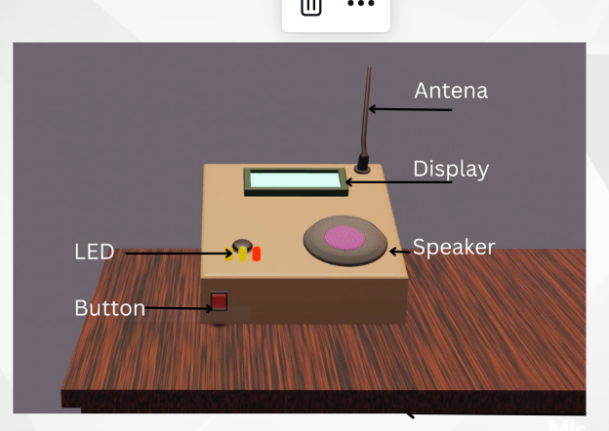
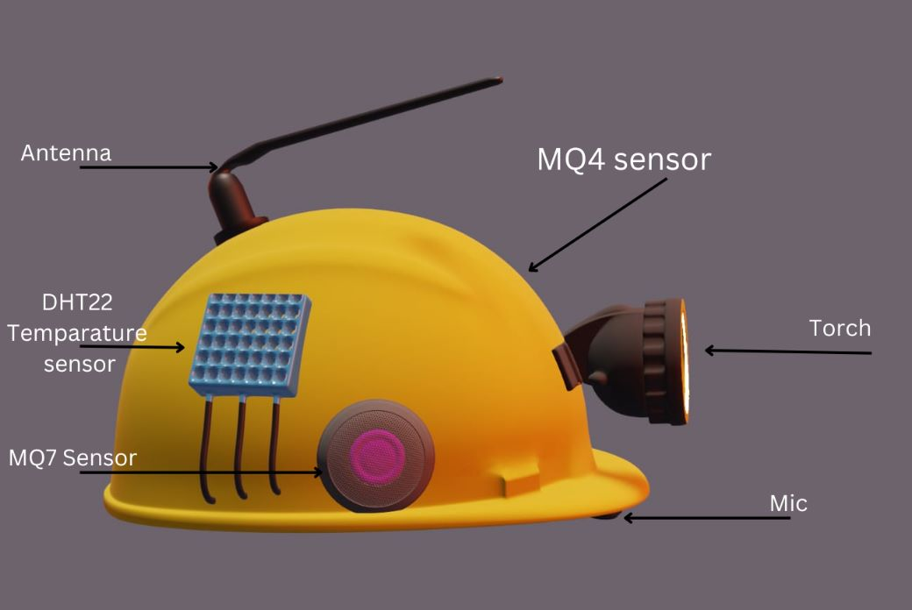
3D design
Receiver station
Helmet

Slide 9
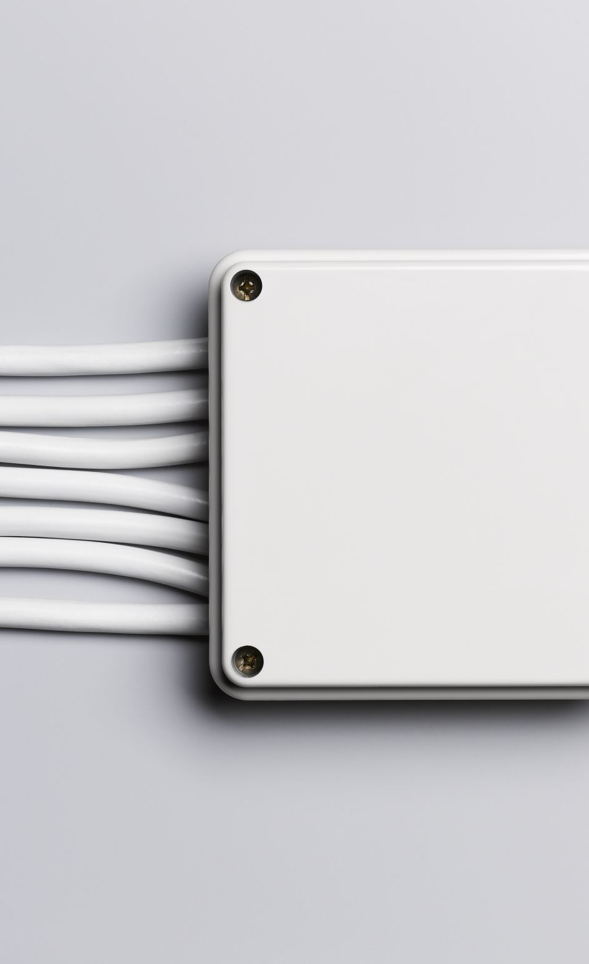
Resource required
Hardware
MQ4 sensor
MQ7 sensor
DHT22 sensor
NRF24L01
Arduino nano
Arduino uno
mics
16x4 display
Speakers
Software
Arduino IDE - codes
Blender – 3D design
EasyEDA – PCB layout

Slide 10
Cost estimate
Item | Quantity | Unit price(Rs) | Price(Rs)
Arduino nano | 1 | 2530 | 2530
Arduino uno | 1 | 1500 | 1500
NRF 24L01 | 3 | 860 | 2580
MQ4 sensor | 1 | 540 | 540
MQ7 sensor | 1 | 550 | 550
DHT22 temperature sensor | 1 | 800 | 800
16*4 Lcd display | 1 | 1200 | 1200
NRF 24L01 Base module | 3 | 275 | 825
I2C Adapter Board | 1 | 250 | 250
PAM8403 stereo audio amplifier | 2 | 130 | 260
8 Ohm 0.5W Speaker | 2 | 100 | 200
Condenser mic | 2 | 40 | 80
LM2596 buck converter | 1 | 320 | 640
5V SMPC power adapter | 2 | 550 | 1100
3.7V 18650 battery | 2 | 1020 | 2040
Other |  |  | 5000
Total |  |  | 19875

Slide 11

Individual contribution

Slide 12
214086K
T. A. S. I. Jayalath
Responsibilities
NRF24L01 basics
Transmitter and part of NRF24L01
Compilation of code

Slide 13
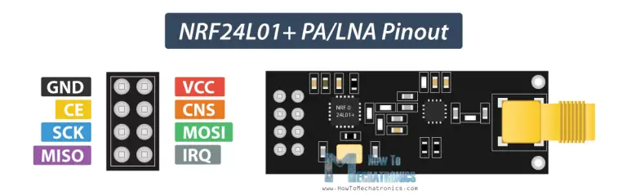
NRF24L01
Specification
2.4GHz RF transceiver Module
Operating Voltage: 3.3V
Communication Protocol: SPI
Baud Rate: 250 kbps - 2 Mbps.
Channels: 126
Low-cost wireless solution
Datasheet

Slide 14
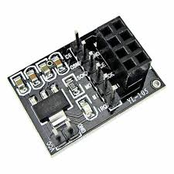
Base module for NRF24L01
Specification
Compatible 8-pin NRF24L01 Series RF Module
Input Voltage: 5V ~ 15V
Output Voltage: 3.3V
Provides power stabilization

Slide 15
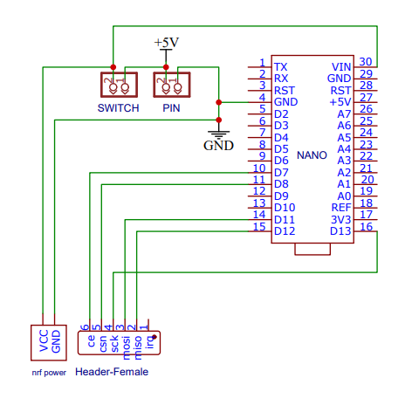
Schematic diagram of NRF24L01 transmitter

Slide 16
Transmitter code
void sendMessage() {
// Read the temperature data from the DHT22 sensor
float temperature = dht.readTemperature();
// Read the CO data from the MQ7 CO sensor
float co_ppm = readCOConcentration();
// Read the CO data from the MQ7 CO sensor
float methane_ppm = mq4Value();
// Create a struct to hold the temperature and CO values
SensorData data;
data.temperature = temperature;
data.co_ppm = co_ppm;
data.methne_ppm = methaneppm;
// Send the temperature and CO data over the radio module
radio.write(&data, sizeof(data));
}
void loop(){
sendMessage();
delay(1000);
}
#include <RF24.h>
#include <SPI.h>
#include <nRF24L01.h>
RF24 radio(7, 8);
// Set radio up using pins 7 (CE) 8 (CS)
// Struct to hold the sensor values
struct SensorData {
float temperature;
float co_ppm;
float methane_ppm;
};
void setup() {
radio.begin();
radio.openWritingPipe(0xF0F0F0F0E1LL);
// Address to send to (6-byte alphanumeric)
}

Slide 17
214023R
A. M. C. I. Athapaththu
Responsibilities
Receiver and repeater part of NRF24L01
Lcd display
I2C module for display

Slide 18
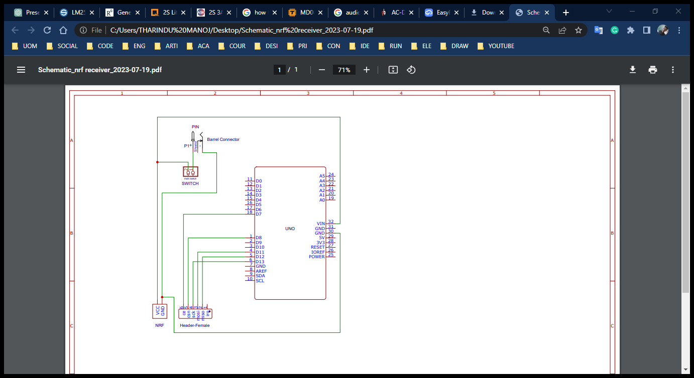
Schematic diagram of NRF24L01 receiver

Slide 19
Receiver code
#include <SPI.h>
#include <nRF24L01.h>
#include <RF24.h>
// Setup the radio module
RF24 radio(7, 8); // CE, CSN
// Define the struct to hold temperature and CO values
struct SensorData {
float temperature;
float CO_ppm;
float other_value;
};
SensorData sensorData; // Create an instance of the struct
void setup() {
Serial.begin(9600);
// Setup the radio module
radio.begin();
radio.openReadingPipe(1, 0xF0F0F0F0D2LL);
radio.startListening();
}
void loop() {
if (radio.available()) {
radio.read(&sensorData, sizeof(sensorData));
// Print the received data
Serial.print("Temperature: ");
Serial.print(sensorData.temperature);
Serial.print(" degC\tCO: ");
Serial.print(sensorData.CO_ppm);
Serial.println("Metane PPM ");
Serial.print(sensorData.other_value );
}
}

Slide 20
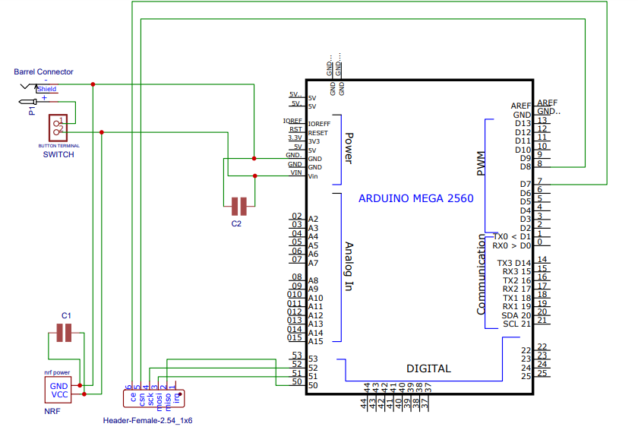
Schematic diagram of NRF24L01 repeater

Slide 21
Repeater code
#include <SPI.h>
#include <RF24.h>
RF24 radio(7, 8); // CE, CSN pins
// Define the struct to hold temperature and CO values
struct SensorData {
float temperature;
float CO_ppm;
float other_value;
};
SensorData sensorData;
void setup() {
radio.begin();
radio.openReadingPipe(1, 0xF0F0F0F0E1LL);
// Address to receive from (6-byte alphanumeric)
radio.openWritingPipe(0xF0F0F0F0D2LL);
// Address to transmit to (6-byte alphanumeric)
radio.startListening();
}
void loop() {
if (radio.available()) {
radio.read(&sensorData, sizeof(sensorData));
radio.stopListening();
radio.write(&sensorData, sizeof(sensorData));
radio.startListening();
}
}

Slide 22
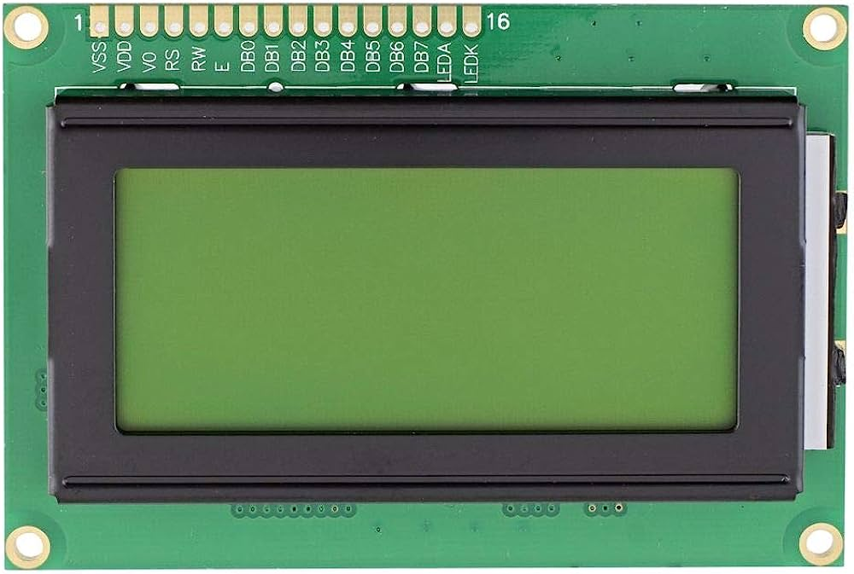
16x4 LCD Display
Specification
Contains 16 pins
Operate in 4bit mode or 8bit modes.
Resolution:16 columns and 4 rows
Total Characters: 64 (16x4)
Used to display sensor values and mine condition
Viewing area: 60x32.6mm
I2C communication protocol
Datasheet

Slide 23
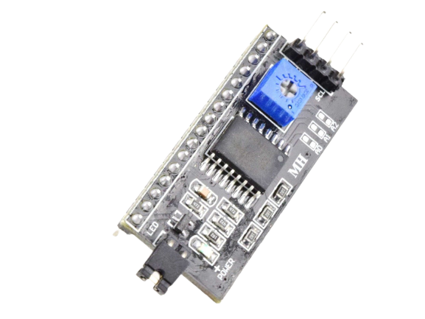
I2C PCF8574T
Reduce no of wires
Contains PCF8574T chip
Using I2C can adjust the display’s contrast
Only used two pins to connect LCD to the Arduino board
(SDA, SCL)
VCC
GND
SDA
SCL
Specification
Maximum voltage 7V
Maximum current 20mA
Operating Temperature -20° C to +70°°C
I2C Address range - 0x20 to 0x27
(Default =0x27,Addressable)
Backlight Jumper
Datasheet

Slide 24
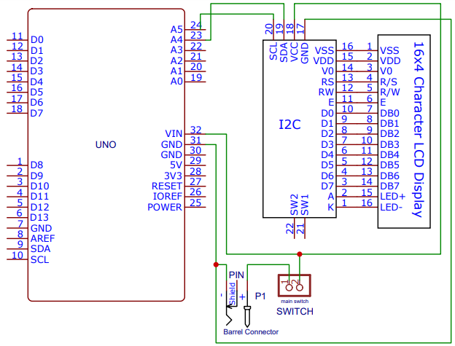
Schematic diagram of I2C and Lcd display

Slide 25
I2C lcd display code
#include <LiquidCrystal_I2C.h> //libraries for lcd display
#include <Wire.h>
LiquidCrystal_I2C lcd(0x27, 16, 4); // Set the I2C address and dimensions of the display
void setup() {
lcdsetup(); //calling lcdsetup function for setting up the lcd display
}
//lcd display function for the begining of the receiver station
void lcdsetup() {
lcd.begin(); // Initialize the LCD
lcd.backlight(); // Turn on the backlight
lcd.setCursor(0, 1); // Set the cursor to the beginning of the second line
lcd.print("____MINOR_____"); // Print a message
lcd.setCursor(-4, 2); // Set the cursor to the beginning of the third line
lcd.print("_SAFETY HELMET");
delay(1000);
lcd.clear(); //clear the display
}
//lcd display function when sensor values receiving
void lcdloop(float temp, float meth, double co) {
lcd.setCursor(0, 0); // Set the cursor to the beginning of the first line
lcd.print("MINE CONDITION");

Slide 26
lcd.setCursor(0, 1); // Set the cursor to the beginning of the second line
lcd.print("Temp(c) :");
lcd.print(temp);
lcd.setCursor(-4, 2); // Set the cursor to the beginning of the third line
lcd.print("Methan(ppm):");
lcd.print(meth);
lcd.setCursor(-4, 3); // Set the cursor to the beginning of the fourth line
lcd.print("CO(ppm) :");
lcd.print(co);
}
//lcd display function when audio transmission
void lcdLoopAudio(){
lcd.clear(); //clear the display
lcd.setCursor(2, 0);
lcd.print("Audio->");
lcd.print(124-(millis()/1000)); //display the remaining seconds of audio transmission
lcd.print(" Sec");
lcd.setCursor(0, 1);
lcd.print("Temp(c) :");
lcd.print(tempAudio);
lcd.setCursor(-4, 2);
lcd.print("Methan(ppm):");
lcd.print(CH4Audio);
lcd.setCursor(-4, 3);
lcd.print("CO(ppm) :");
lcd.print(CoAudio);
delay(1000);
}

Slide 27
214211R
W. A. T. M. Thilakarathna
Responsibilities
Audio transmission part of NRF24L01
Power supply
Designing the PCB
3D design
Making the structure

Slide 28
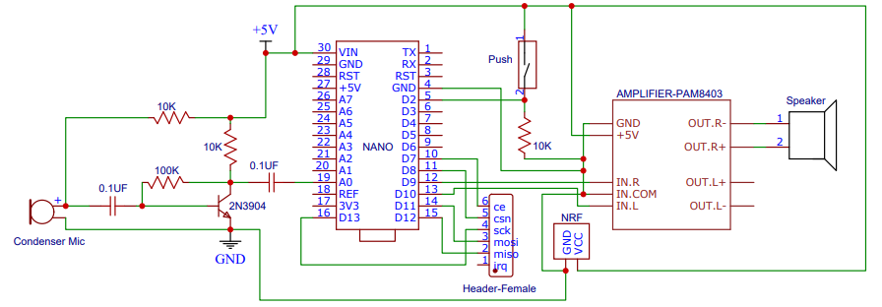
Schematic diagram of NRF24L01 audio transmission circuit

Slide 29
NRF24L01 audio transmission code
#include <RF24.h>
#include <SPI.h>
#include <RF24Audio.h>
RF24 radio(7,8);
// Set radio up using pins 7 (CE) 8 (CS)
RF24Audio rfAudio(radio, 1);
const int buttonPin = 2; // Replace with the actual pin number of the button
bool pressButton = false;
void setup() {
radio.begin();
rfAudio.begin();
rfAudio.setVolume(7);
}
void loop() {
// Check if the button is pressed
if (digitalRead(buttonPin) == HIGH) {
// Button is pressed, start transmitting audio
if (!pressButton) {
rfAudio.transmit();
pressButton = true;
}
} else {
// Button is not pressed, start receiving audio
if (pressButton) {
rfAudio.receive();
pressButton = false;
}
}
}

Slide 30
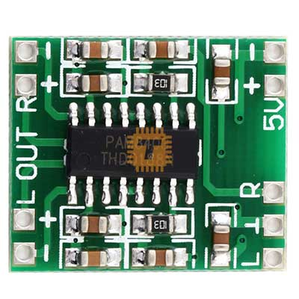
PAM8403 audio amplifier
Specification
Dual channel stereo output 3W+3W power Class D
High amplification efficiency 85%
Can directly drive 4Ω / 8Ω small speakers
Good sound quality & noise suppression
Unique without LC filter class D digital power board
Can use computer USB power supply directly
Datasheet

Slide 31
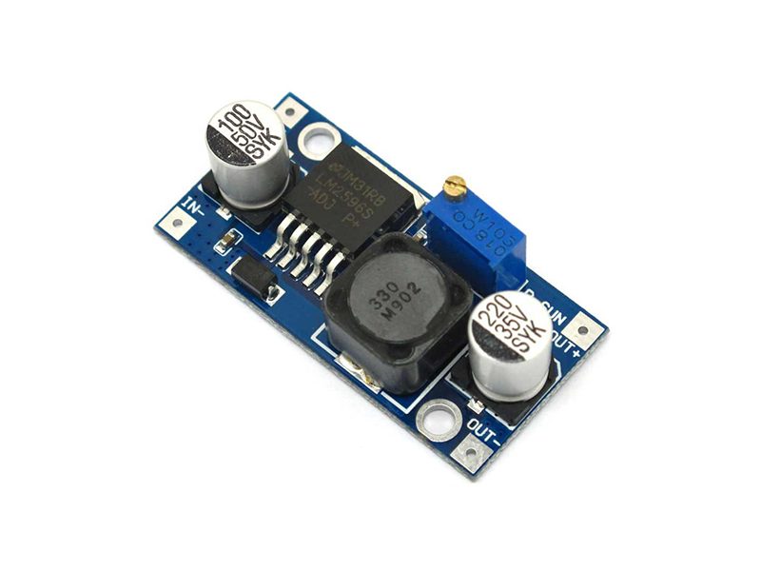
LM2596 buck converter
Specification
Input voltage 3.2V ~ 40V
Output voltage 1.25V ~ 35V
Output current 3A (max)
The conversion efficiency of 92% (maximum)
Datasheet

Slide 32
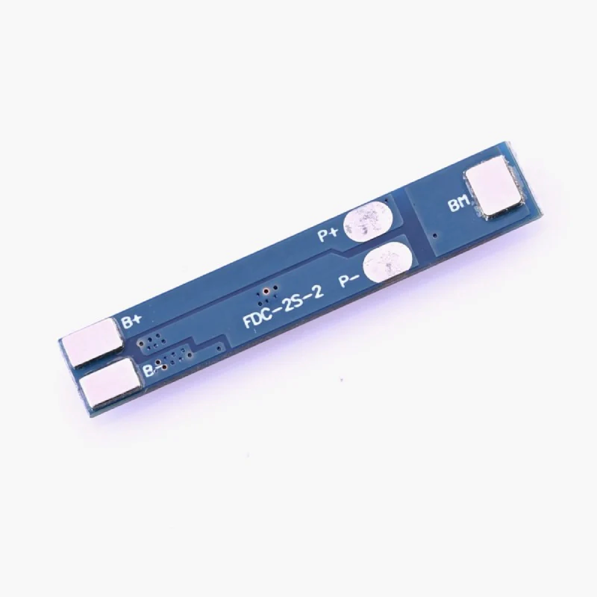
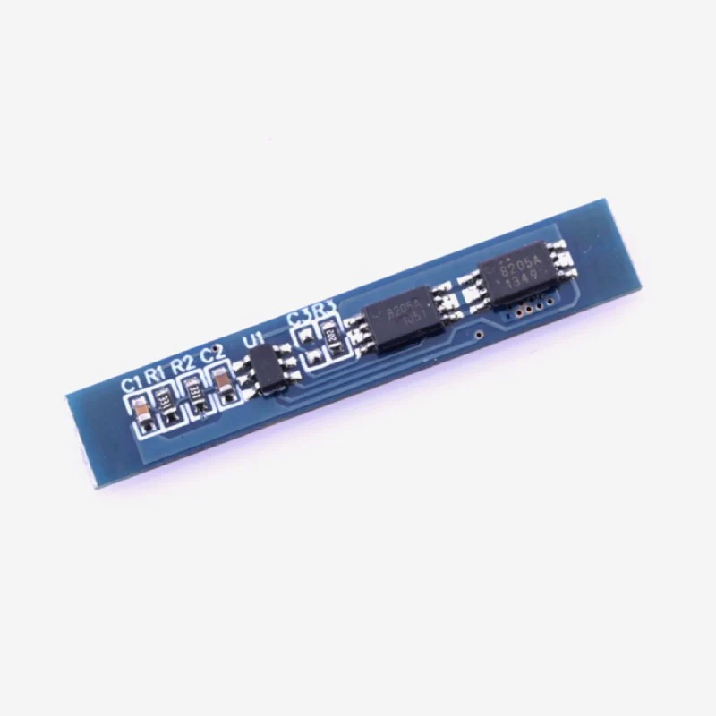
TP4056
2S Lithium-ion Battery Protection Board
Specification
Short circuit protection
Overcharge protection
Overcurrent protection
Maximum Working Current: 3A
Operating Temperature: -40 to 50°C
Internal Resistance: Less than 45mΩ
Datasheet

Slide 33
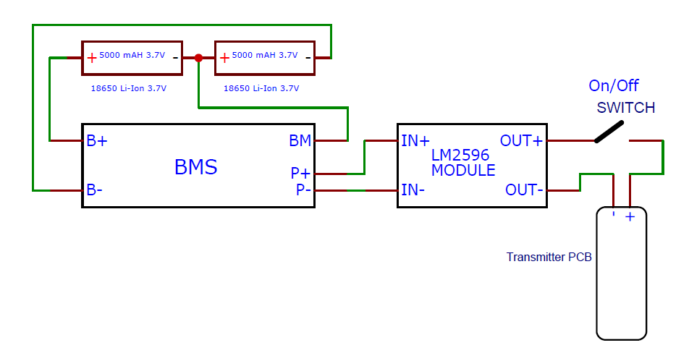
Schematic diagram of power supply

Slide 34
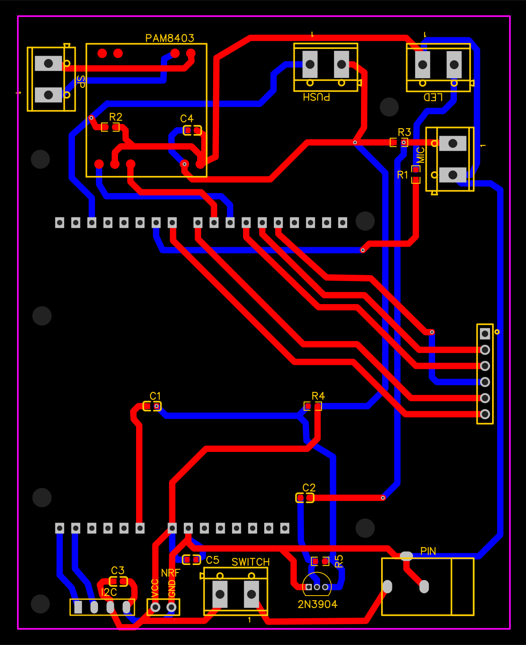
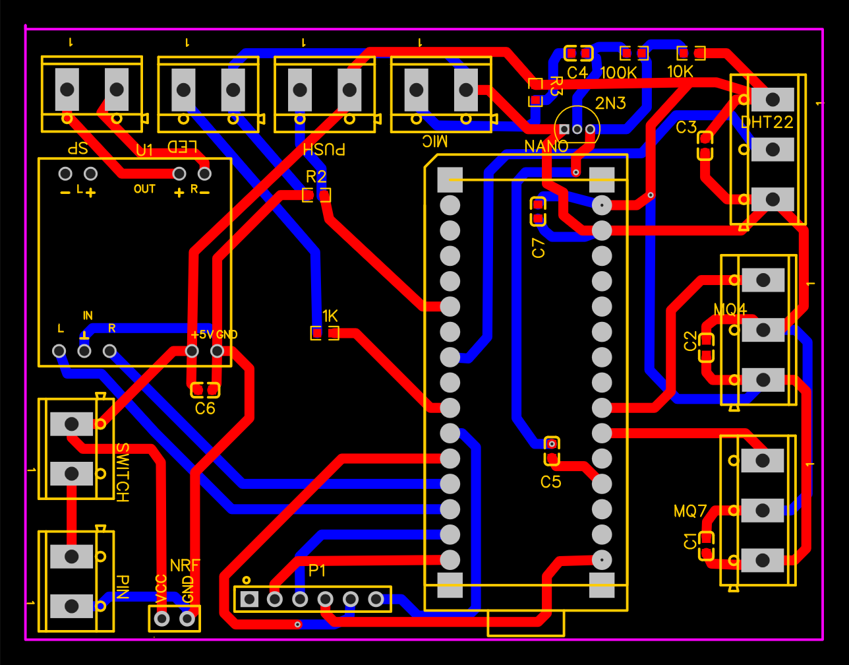
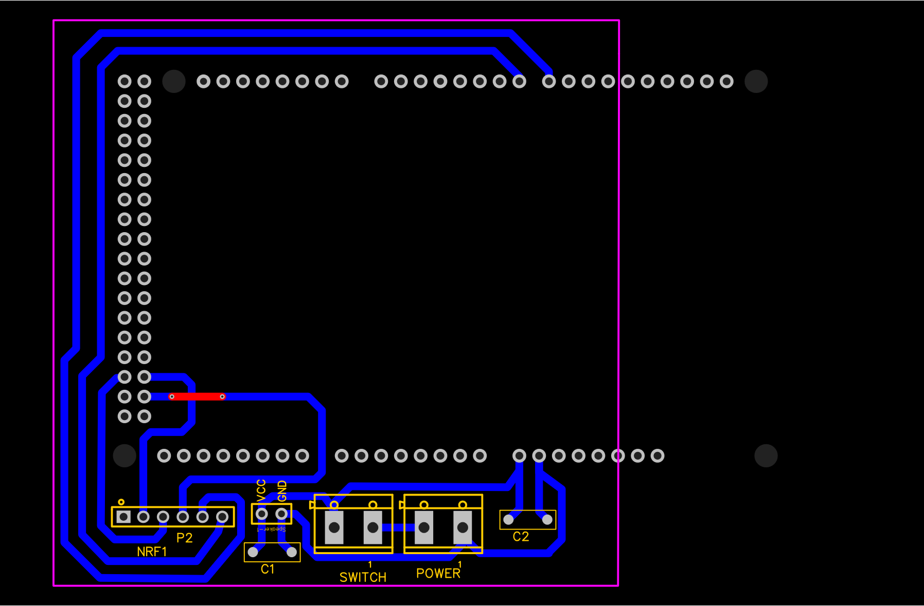
PCB layouts
Transmitter
Receiver
Repeater

Slide 35
214007X
A. D. R. V. Abeysiri
Responsibilities
Arduino basics
MQ4 sensor
DHT22 temperature sensor

Slide 36
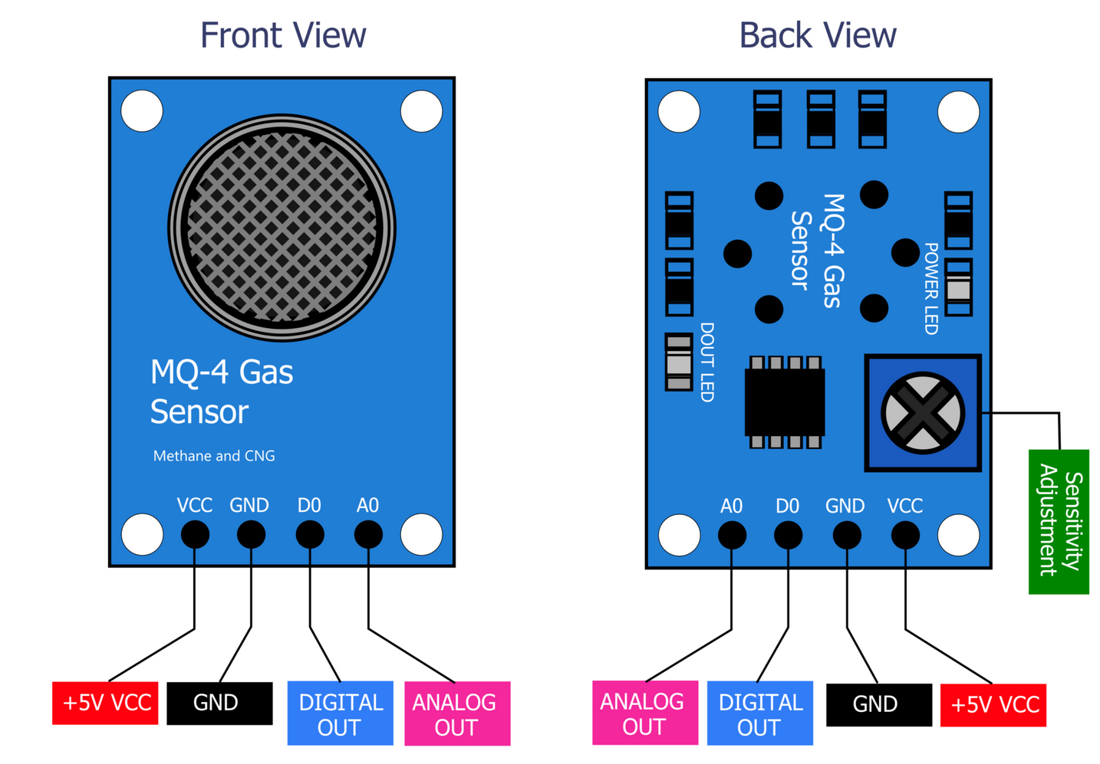
MQ4 sensor
Specification
Circuit and heating voltage - 5V
Load resistance - 20 k ohm
Heater resistance - 33 ohm
Heating consumption - less than 750mw
Using temperature - -10℃-50℃
Storage temperature - -20℃-70℃
Detecting concentration - 200ppm - 10000ppm
Sensing resistance - 10KΩ- 60KΩ
Datasheet

Slide 37
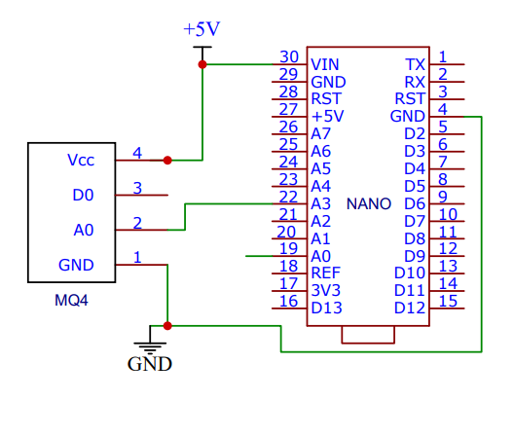
Schematic of MQ4 sensor

Slide 38
MQ4 code
const int MQ4Sensor = A0;
// MQ4 Sensor output connected to Arduino's A0 pin
// Calibration value
float R0 = 10.0;
// This is the resistance in the sensor in clean air at 1000ppm
float RL = 20.0;
void setup() {
Serial.begin(9600);
}
void loop() {
float sensor_volt;
float RS_gas; // Get value of RS in a GAS
float ratio; // Get ratio RS_gas/RS_air
sensor_volt = analogRead(MQ4Sensor);
sensor_volt = sensor_volt/1024*5.0;
RS_gas = ((5.0-sensor_volt)/sensor_volt)*RL;
// Calculate RS in GAS
ratio = RS_gas/R0; // ratio = RS/R0
ppm= pow(ratio,-1.85);
Serial.print("ppm= ");
Serial.println(ppm);
delay(1000);

Slide 39
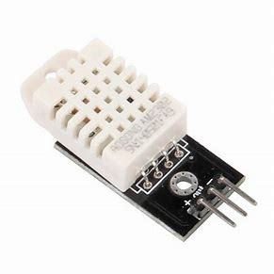
DHT22 temperature sensor
Specification
Power supply - 3.3- 6V DC
Operating range - -40~80Celsius
temperature <+-0.5Celsius
Datasheet

Slide 40
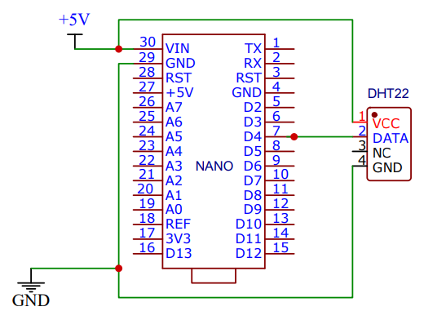
Schematic of DHT22 sensor

Slide 41
DHT22 code
#include <DHT.h>
// Setup the DHT22 sensor
#define DHTPIN 4 // Digital pin connected to the DHT sensor
#define DHTTYPE DHT22 // DHT22 (AM2302)
DHT dht(DHTPIN, DHTTYPE);
void setup(){
// Setup the DHT22 sensor
dht.begin();
serial.begin(9600);
}
void loop(){
// Read the temperature data from the DHT22 sensor
float temperature = dht.readTemperature();
serial.print("temp= ");
serial.println(temperature);
delay(1000);
}

Slide 42
214177P
A. S. F. Sahla
Responsibilities
MQ7 sensor
DHT22 temperature sensor

Slide 43
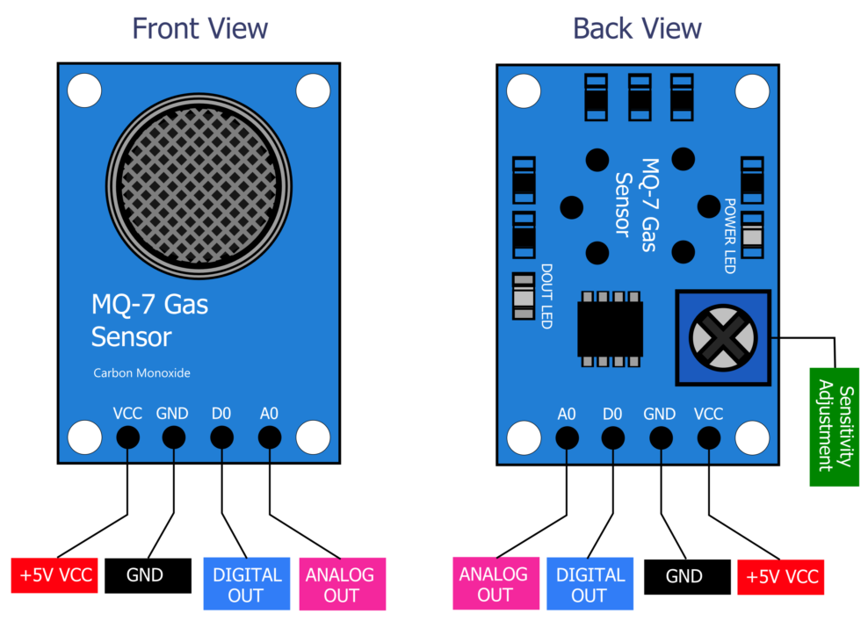
MQ7 sensor
Specification
Circuit voltage 5V
Heating voltage high 5V
Heating voltage low 1.4V
Load resistance - can adjust
Heating resistance - 33 ohm
Using temperature - -20℃-50℃
Storage temperature - -20℃-50℃
Detecting range - 20ppm - 2000ppm
Datasheet

Slide 44
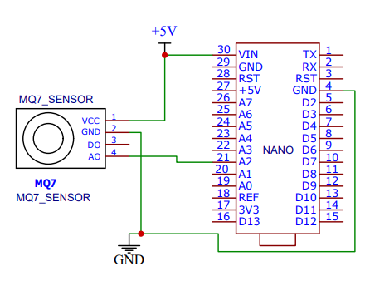
Schematic of MQ7 sensor

Slide 45
MQ7 code
int gas_sensor = A0; // Sensor pin
float m = -0.6527; // Slope
float b = 1.30; // Y-Intercept
float R0 = 21.91;
// Sensor Resistance in fresh air from previous code
void setup() {
Serial.begin(9600); // Baud rate
pinMode(gas_sensor, INPUT); // Set gas sensor as input
}
void loop() {
float ppm = readCOConcentration();
// Read CO concentration value from the sensor
Serial.print("CO Concentration (ppm) = ");
Serial.println(ppm);
delay(2000);
}
float readCOConcentration() {
float sensor_volt;
// Define a variable for sensor voltage
float RS_gas;
// Define a variable for sensor resistance
float ratio; // Define variable for ratio
int sensorValue = analogRead(gas_sensor);
// Read analog values of the sensor
Serial.print("GAS SENSOR RAW VALUE = ");
Serial.println(sensorValue);
sensor_volt = sensorValue * (5.0 / 1023.0);
// Convert analog values to voltage
Serial.print("Sensor value in volts = ");
Serial.println(sensor_volt);
RS_gas = ((5.0 * 10.0) / sensor_volt) - 10.0;
// Get value of RS in a gas
Serial.print("Rs value = ");
Serial.println(RS_gas);
ratio = RS_gas / R0; // Get ratio RS_gas/RS_air
Serial.print("Ratio = ");
Serial.println(ratio);
double ppm_log = (log10(ratio) - b) / m;
// Get ppm value in linear scale according to the ratio
double ppm = pow(10, ppm_log);
// Convert ppm value to log scale
Serial.print("CO Concentration (ppm) = ");
Serial.println(ppm);
return ppm;
}

Slide 46
Testing video

Slide 47
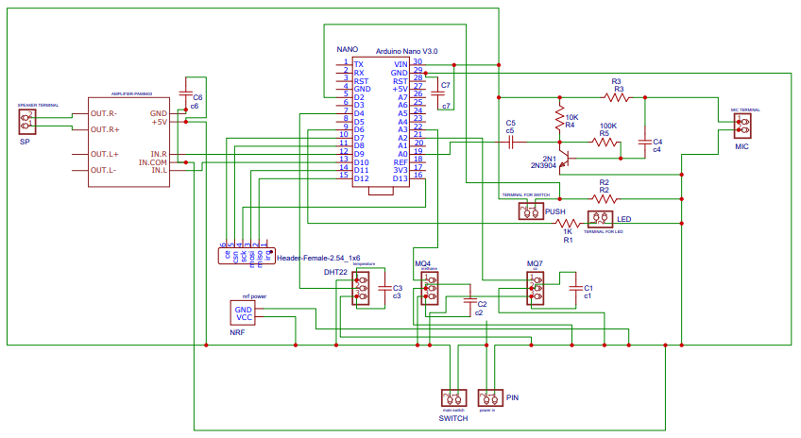
Schematic of transmitter

Slide 48
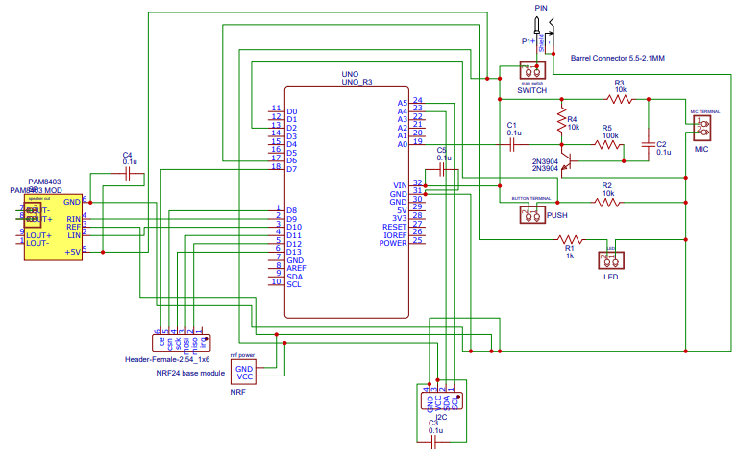
Schematic of receiver

Slide 49
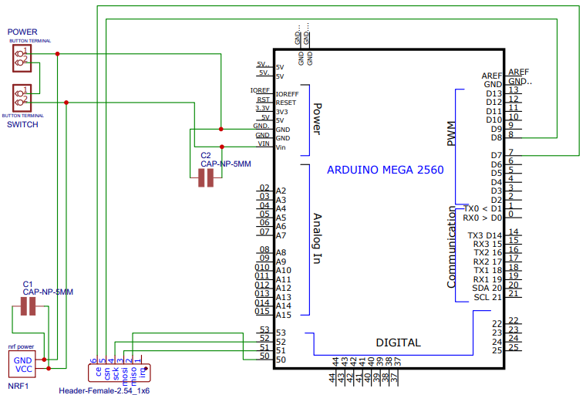
Schematic of repeater

Slide 50

Q & A

Slide 51

THANK YOU!

